Slide 1


2025
Chime
GENDER PAY GAP
REPORT

Slide 2









CONTENTS
Introduction to Gender Pay Gap
Provides an overview of the gender pay gap report and its purpose.
Industry Context & Metrics Reporting
Outlines the industry context and shares Chime’s GPG metrics.
What This Means
Insights from Chime on what the metrics indicate.
Planned Initiatives for 2026
Chime’s action plan to address any gender pay gap and drive progress.

Slide 3


INTRODUCTION TO
GENDER PAY GAP
The European Commission's Gender Equality Strategy 2020–2025 prioritises equal access to the economy for both women and men. A key objective is closing gender gaps in the labour market and promoting equal opportunities.
Aligned to this objective, the Gender Pay Gap Information Act 2021 and its related statutory instruments requires Irish employers to report on their gender pay gaps, grounded in transparency, accountability, and progress on workplace gender equality.

Slide 4


9.6%
IRELAND'S GENDER PAY GAP
(CSO 2022)
12%
GPG IN CONTEXT
EU AVERAGE GENDER PAY GAP
(EUROSTAT 2023)
KEY STATISTICS
11.2%
Corporate Reports published in Ireland
(2023)
GLOBAL GENDER PAY GAP
31.5%
(WORLD ECONOMIC FORUM 2024)
*Sources: Central Statistics Office (CSO), Eurostat, Corporate published reports, World Economic Forum

Slide 5


GENDER PAY GAP EXPLAINED
Definition
Key Factors
The Gender Pay Gap (GPG) represents the difference in the average hourly wage of men and women across the entire workforce.
It’s important to note that a gender pay gap does not mean unequal pay for equal work. The right to equal pay for equal work in Ireland is already protected under the Employment Equality Acts 1998–2015, the gender pay gap typically reflects differences in how men and women are represented across various roles and levels within an organisation.
GPG reports seek to identify themes or patterns that influence high gender pay gaps and seeks to address those through targeted initiatives.
The mean GPG, is found by finding the average hourly pay of all men and the average of all women and expressing the difference as a percentage.
The median GPG is found by comparing the middle-paid women’s hourly pay with the middle-paid man and expressing the difference as a percentage.
A positive Gender Pay Gap means women earn less than men on average.
A negative Gap means men earn less than women on average.
The legislation requires that only male and female genders are reported, so non-binary employees are omitted for the purpose of GPG reporting.

Slide 6

Chime
CEO STATEMENT
Mark Byrne
CEO, Chime
“I am pleased to share our 2025 Gender Pay Gap Report, prepared in accordance with the Gender Pay Gap Information Act 2021. This legislation requires all employers with 50 or more employees to publish data on the differences in average hourly pay between men and women and to explain the reasons for any gaps.
For us at Chime, this report is more than a legal requirement. As a not-for-profit organisation, we exist to make a difference in people’s lives. That means we must lead by example and ensure that our own workplace reflects our values, our commitment to equality and the principles we advocate for in the communities we serve. We cannot achieve that mission unless we ensure fairness, inclusion, and respect within our own organisation.”

Slide 7




REFLECTING ON OUR 2025 RESULTS
Chime’s Gender Pay Gap 2025 Report is based on a reference period between 2nd June 2024 – 1st June 2025. On the snapshot date of 1st June 2025, there were a total of:
88
14
5
PEOPLE EMPLOYED
(66 female; 22 male)
PART-TIME PEOPLE EMPLOYED
TEMPORARY PEOPLE EMPLOYED

Slide 8


Industry Context
Reflecting on Our 2025 Results
The Gender Pay Gap Information Act 2021 mandates annual GPG reporting for organisations with: 50+ employees from 2025, which will bring a much larger proportion of not-for-profit organisations into scope, including charities, community groups, and voluntary organisations. The sector is female-dominated, with the Wheel reporting women making up 75% of the workforce and 68% of management. Interestingly they report, (71%) of males are in the top two levels of management, compared to 56% of females. Consequently, higher proportions of females (44%) are found in the lower levels of management, than males (29%).
The Wheel report on GPG in 2023 reported mean GPG ranges from a minus figure of -16.89% to a plus of 22.6% which shows a significant variance across the sector. Where GPG’s were higher percentages, influencing factors appear to be women concentrated in lower-paid care roles and the tendency of women to avail of flexible working arrangements i.e. part-time or take career breaks.
Measures being implemented to improve where gender pay gaps exists include more inclusive recruitment: practices such as gender-neutral job advertisements and diverse interview panels, a focus on building towards improved pay transparency with clear salary bands and no negotiation policies with the EU Pay Transparency Directive expected to further enforce transparency and corrective action. Support to female development and progression within organisations with low senior female representation has also been a key focus for some organisations with concerns that hybrid work may disadvantage women due to visibility.

Slide 9
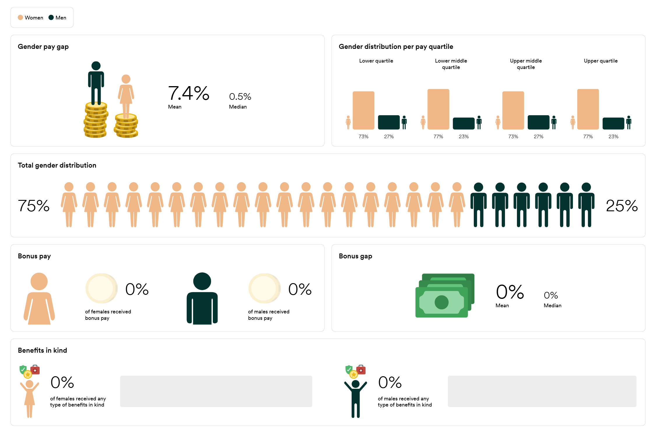
CHIME’S GENDER PAY GAP OVERVIEW 2025
7.4%
Mean
0.5%
Median
METRICS REPORTING

Slide 10





GENDER PAY GAP
Mean & Median Hourly Gender Pay Gap (Part time)
Mean & Median Hourly Gender Pay Gap (Temporary)
MALE
FEMALE
N/A
Gender pay gap – part time employees
(Mean)
There are no males working in part time or temporary roles within the Organisation.
Therefore, there is no gender pay gap to report on in either of these categories.
N/A
(Median)
METRICS REPORTING
Gender pay gap – temporary employees
N/A
(Mean)
N/A
(Median)

Slide 11


GENDER BONUS & BIK PAY GAP
Percentage of males to receive a performance related bonus remuneration & BIK
Percentage of females to receive a performance related bonus remuneration & BIK
Mean & Median Hourly performance related bonus (All)
MALE
FEMALE
Gender pay gap - Bonus
N/A
There are no bonus payments made to any employees within the Organisation. Therefore, there is no gender pay gap to report on in this category.
(Mean)
N/A
(Median)
METRICS REPORTING
Received bonus
Received benefits in kind
There are no BIK benefits provided to any employees within the Organisation. Therefore, there is no gender pay gap to report on in this category.
0%
0%
0%
0%
Male
Female
Male
Female

Slide 12


QUARTILE DISTRIBUTION
Percentage of male and female employees within lower remuneration quartile
Percentage of male and female employees within lower middle remuneration quartile
Percentage of male and female employees within upper middle remuneration quartile
Percentage of male and female employees within upper remuneration quartile
MALE
FEMALE
Gender distribution per pay quartile
73%
77%
73%
77%
METRICS REPORTING
27%
23%
27%
23%
Lower Quartile
Lower Middle Quartile
Upper Middle Quartile
Upper Quartile

Slide 13


WHAT THIS MEANS
Key Findings
In our first year of reporting our gender pay gap, the analysis shows a mean gender pay gap of 7.4 percent and a median gender pay gap of 0.5 percent. While these figures are lower than the national average, we are conscious that every gap, no matter how small, represents an opportunity to improve.
All part time and temporary employees in the organisation are female which explains the why we don’t have gender pay gaps here. There is no bonus or BIK offering as part of the total compensation package and therefore these data points are also not of significance.
Understanding the Gap
Each pay quartile has a higher volume of females than males and there is good mix of gender pay distribution. All employees are on pay scales which are gender neutral, which supports a fair pay structure. However, with a population the size of Chime one or two salaries can change the figures. Within this reference period, there have been more males than females in the upper pay quartile occupying senior leadership roles. The mean Gender pay gap as reported reflects this structure. The median gender pay gap of 0.5% is more accurately reflective of the overall gender pay gap reality within the organisation.

Slide 14


PLANNED INITIATIVES FOR 2026
We take our obligations under the Gender Pay Gap Information Act 2021 seriously. This report has been prepared in full compliance with these statutory requirements, reflecting both our transparency and our broader corporate responsibility to employees, investors, and the wider community. While legislation mandates reporting, we view it as a strategic opportunity to hold ourselves accountable and to contribute positively to the industry-wide conversation about representation, inclusion, and equity in Ireland’s not for profit sector.
Supporting Flexible Working
Transparent Pay Structures
We know that many of our male colleagues’ balance work with caring responsibilities and community commitments. To support them, we will communicate our flexible working arrangements to explore what barriers exist for men to take up part time/flexible working arrangements and seek to remove barriers that disproportionately dissuade our male colleagues from availing of these opportunities.
In preparation for the EU Transparency Directive’s transposition, establish clear and consistent pay bands and criteria for progression to safeguard against subjective salary decisions.

Slide 15
CLOSING STATEMENT
Under the Gender Pay Gap Information Act 2021, we are required not only to publish data but also to explain the factors driving any gaps and to outline the measures we are taking to address them. We take this responsibility seriously.
This report is an important step in our ongoing journey to foster a workplace where everyone feels valued, respected, and supported. It provides a clear view of where we are now and what we are doing to improve. But transparency is more than a compliance exercise for us; it is an expression of our values. By sharing our results openly, we hold ourselves accountable to our employees, our volunteers, our donors, and the communities we serve.
As a not-for-profit organisation, our success is built on the passion, commitment, and expertise of the people who work and volunteer with us. We are fortunate to have a workforce driven by purpose and a belief in positive change. I want to thank all our employees, partners, and stakeholders for their continued commitment to our work and for helping us to sustain an organisation that reflects the values we stand for. Together, we can continue to build a workplace and a society where fairness, inclusion, and opportunity are at the heart of everything we do.
Mark Byrne
Chief Executive Officer
Chime
Notes:
As a not-for-profit organisation, we exist to make a difference in people’s lives. That means we must lead by example and ensure that our own workplace reflects the principles we advocate for in the communities we serve.
Promoting equality, diversity, and inclusion is central to our mission. It strengthens our culture, drives innovation, and enables us to deliver more effective support to the people who rely on us. We know that when our workforce better reflects the diversity of society, we are better placed to understand and respond to the needs of those we serve.

Slide 16





Chime's comprehensive 2025 Gender Pay Gap Report showcases the company's commitment to addressing gender imbalances in the workplace.
By transparently sharing their results and planned initiatives, the organisation demonstrates its dedication to fostering a more equitable and inclusive work environment.
The report serves as a valuable resource for stakeholders, employees, and industry peers, showcasing Ireland's leadership in promoting gender equality and driving meaningful change.

Slide 17
GENDER PAY GAP METRICS
1. Mean hourly gender pay gap (all) | 7.4 %
2. Mean hourly gender pay gap (part-time) | N/A
3. Mean hourly gender pay gap (temporary) | N/A
4. Median hourly gender pay gap (all) | 0.5%
5. Median hourly gender pay gap (part-time) | N/A
6. Median hourly gender pay gap (temporary) | N/A
7. Mean hourly performance related bonus gender pay gap (all) | N/A
8. Median hourly performance related bonus gender pay gap (all) | N/A
9. Percentage of employees per gender to receive a performance related bonus remuneration | (M) 0%
 | (F) 0%
10. Percentage of employees per gender to receive benefit-in-kind | (M) 0%
 | (F) 0%
11. Percentage of employees within lower remuneration quartile | (M) 27%
 | (F) 73%
12. Percentage of employees within lower middle remuneration quartile | (M) 23%
 | (F) 77%
13. Percentage of employees within upper middle remuneration quartile | (M) 27%
 | (F) 73%
14. Percentage of employees within upper remuneration quartile | (M) 23%
 | (F) 77%
APPENDIX: STATUTORY REPORTING

Slide 18







2025
info@adarehrm.ie
www.adarehrm.ie
DUBLIN
SHANNON
CORK
(01) 561 3594
(061) 363 805
(021) 486 1420
2nd Floor,
43-51 Temple Grove House,
Temple Road, Blackrock,
Co. Dublin,
A94 E7F8
Shannon Airport House,
Suite 14, Free Zone,
Shannon,
Co. Clare,
V14 E370
Penrose Wharf Bus. Centre,
14 Penrose Wharf,
Cork,
Co. Cork,
T23 EK0E

